Slide 1

Capstone Project Phase 1
Breast cancer cells classification using CNN
Supervisor: Ronen Zilber Students: Shenhav Hezi, Tomer Boyanjo
Notes:
Shenhav

Slide 2
Table of Contents
Introduction
Breast cancer as of today
Motivation
CNN
DenseNet
Inception
Datasets:
BreakHis
DDSM
Researched hyperparameters
Technologies
Google Collab
Results
GUI
Conclusion
2

Slide 3
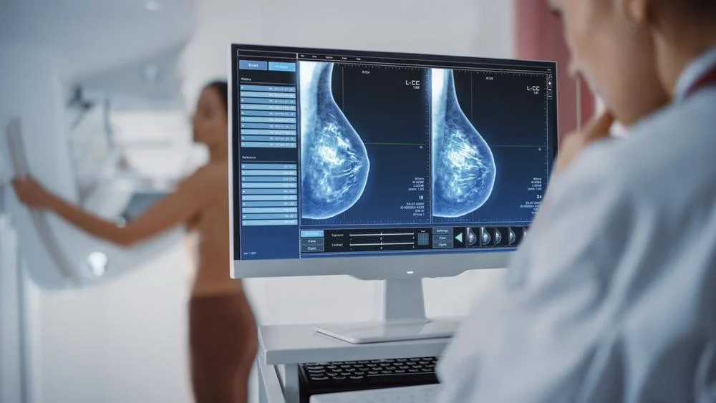
breast cancer cells classification using CNN on histopathology and mammography imaging - Introduction
Breast cancer is the second most diagnosed cancer worldwide. Breast cancer occurs in four main types: normal, benign, in-situ cancer and invasive cancer.
Notes:
Benign = not danger but have a chance in future to be a breast cancer.
In-situ cancer = cancer cells that not spread out yet.
Invasive carcinoma = cancer cells which spread out to another parts of the breasts.

Slide 4
breast cancer cells classification using CNN on histopathology and mammography imaging - Introduction
Breast cancer can be diagnosed using several approaches, two of them:
Histopathology images, which are microscopic images of breast tissue that are extremely useful in early treatment of the cancer.
Mammography which is specialized medical imaging that uses a low-dose x-ray system to see inside the breasts. A mammography exam, called a mammogram, aids in the early detection and diagnosis of breast diseases in women.

Slide 5
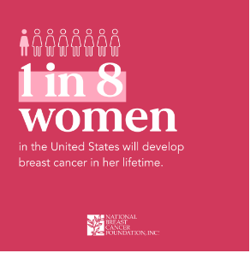

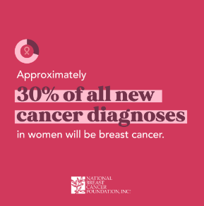
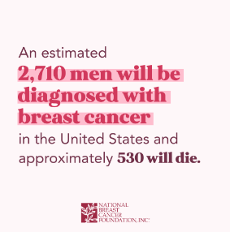
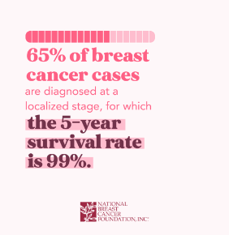
Breast cancer as of today

Slide 6
Motivation
There are places and countries where there is shortage of specialist doctors, and patients cannot get results of test to find whether they have breast cancer quickly enough which can worsen survivability rates for them. Early detection using automated classification tool can bring about these aspects:
earlier detection can drastically improve the patient's survival chances.
waiting time for a diagnosis will be reduced and patient can get treatment earlier.
When there is lack of specialist doctors, these tools can help serve as secondary opinions
6
Notes:
Tomer

Slide 7
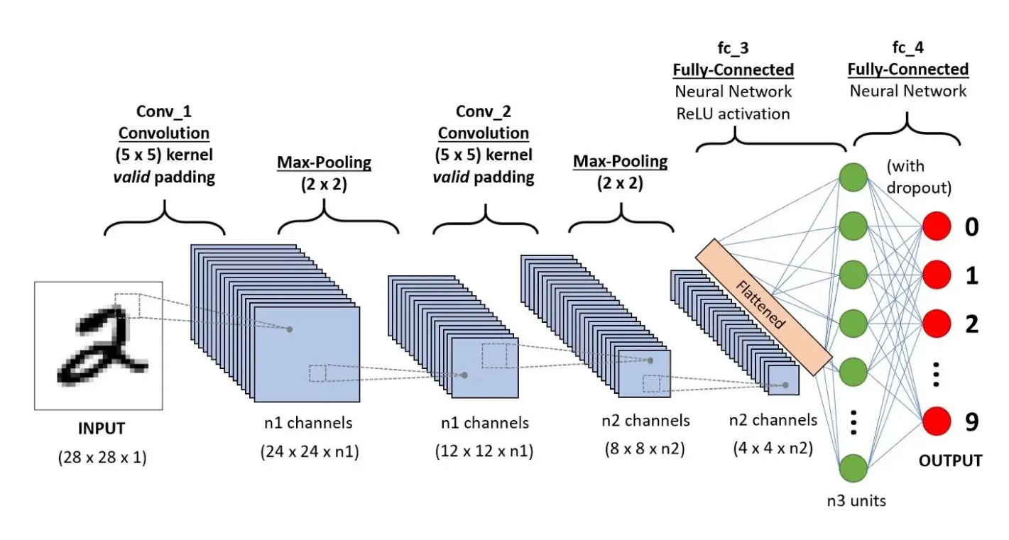
CNN
Convolutional neural networks are a specialized type of artificial neural networks that use a mathematical operation called convolution.
There are usually 3 types of layers in CNNs:
convolution layer
pooling layers
fully connected layer
7
Notes:
convolution layer - Its purpose is to extract features from the image. applying a filter on an input, passing the result to the next layer (feature maps).
pooling layers – Pooling layers reduce the dimensions of data by combining the outputs of neuron clusters at one layer into a single neuron in the next layer.
fully connected layer - maps the extracted features into final output, They come as the last layers after convolution and pooling and these layers take the output of previous layers to classify the output.

Slide 8
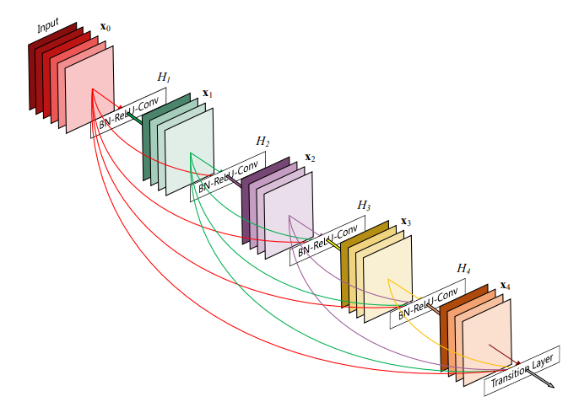
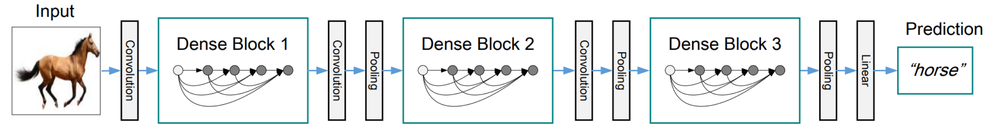
DenseNet
DenseNet is a convolutional neural network architecture that connects each layer to every other layer in a feed-forward fashion.
This architecture is designed to alleviate the vanishing-gradient problem encountered in traditional deep neural networks.
DenseNet can be very deep, with hundreds of layers, and still be able to train effectively.
Source: Densely Connected Convolutional Networks original paper.
8
Notes:
This architecture is designed to alleviate the vanishing-gradient problem encountered in traditional deep neural networks, by using direct connections between layers, rather than stacking layers sequentially.
DenseNet can be very deep, with hundreds of layers, and still be able to train effectively, We will use the DensenNet 121 which is one of the smaller DenseNet architectures contains 4 dense blocks each containing a fixed number of layers.

Slide 9
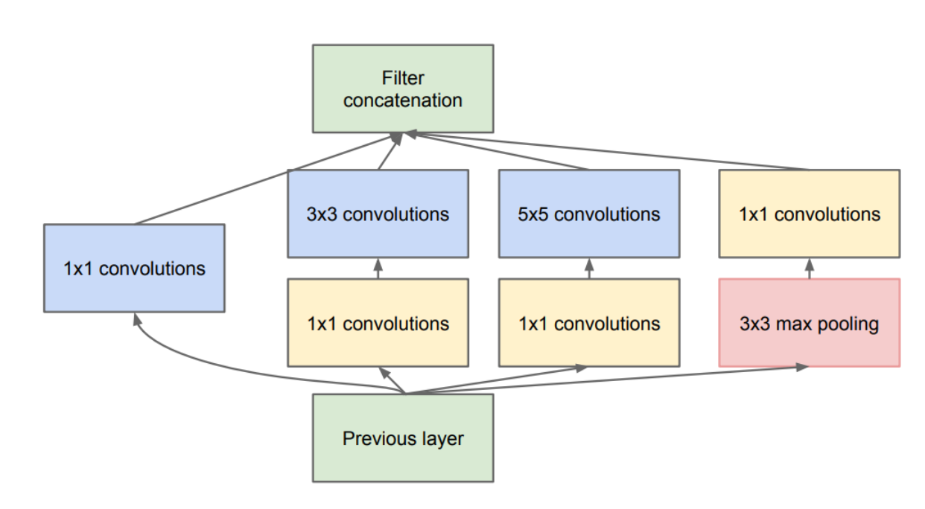
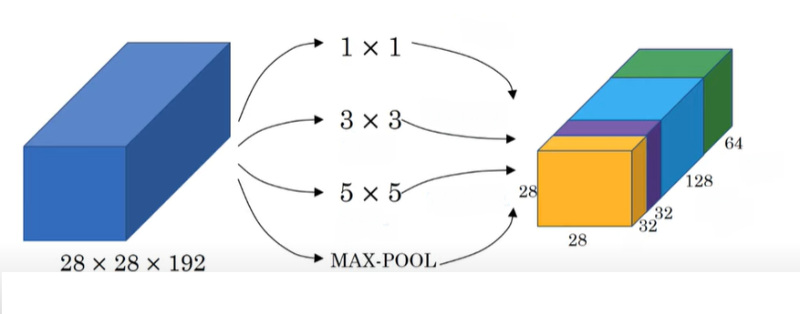
Inception V3
The inception network which was introduced as Googlenet in 2014 takes a new approach to deep layers models where before different types of convolutions and pooling layers were stacked upon each other but now in an inception module we combine within the same layer different convolutions and a pooling.
9

Slide 10
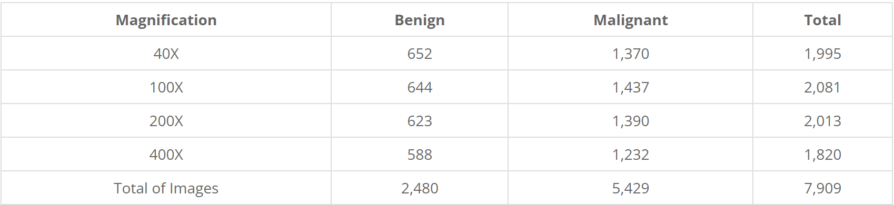
BreakHis
The Breast Cancer Histopathological Image Classification (BreakHis) composed of:
7,909 microscopic images of breast tumor tissue collected from 82 patients using different magnifying factors (40X, 100X, 200X, and 400X).
2,480 benign
5,429 malignant samples (700X460 pixels, 3-channel RGB, 8-bit depth in each channel, PNG format for both benign and malignant images).
The BreaKHis is structured as follows:
Notes:
Shenhav

Slide 11
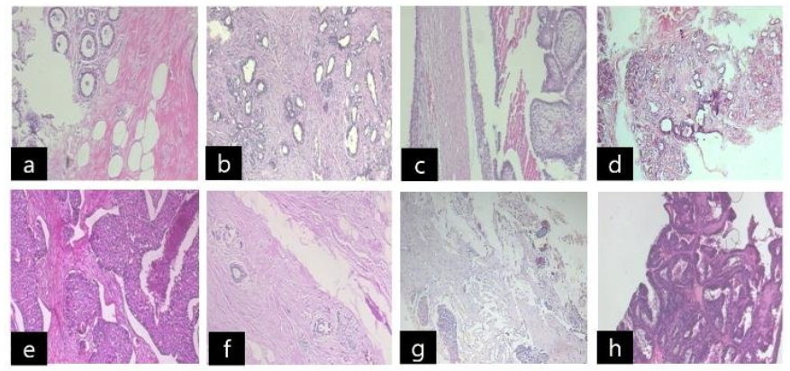
BreakHis
BreakHis dataset composed of benign and malignant images : benign [(a) : adenosis, (b) : fibroadenoma, (c) : phyllodes tumor, (d) : tubular adenoma], malignant [(e) : ductal carcinoma, (f) : lobular carcinoma, (g) : mucinous carcinoma, (h) : papillary carcinoma]
Source: https://www.researchgate.net/figure/BreakHis-dataset-composed-of-benign-and-malignant-images-benign-a-adenosis-b_fig2_327528970
11

Slide 12
DDSM Mammography
The Breast Cancer Mammography Image Classification (DDSM) composed of:
consists of images from the DDSM [1] and CBIS-DDSM [3] datasets.
images have been pre-processed and converted to 299x299 images
The data is stored as tfrecords files for TensorFlow.
dataset contains 55,890 training examples, of which 14% are positive and the remaining 86% negative, divided into 5 tfrecords files.

Slide 13
Researched hyperparameters
Learning rate {0.0005 – 0.000005}, learning rate determines the step size at each iteration while moving toward a minimum of a loss function.
Epochs {50, 100, 150}, specifies the number of epochs or full passes of the entire training dataset through the algorithm’s training or learning process.
Batch size {64, 128}, batch size is the number of samples that are passed through the model before the model is updated. The size of a batch must be less than the number of samples in the training dataset.
Dropout {0.2} Dropout is a technique where randomly selected neurons are ignored during training. They are “dropped out” randomly. Dropout helps combat overfitting of the model
13

Slide 14
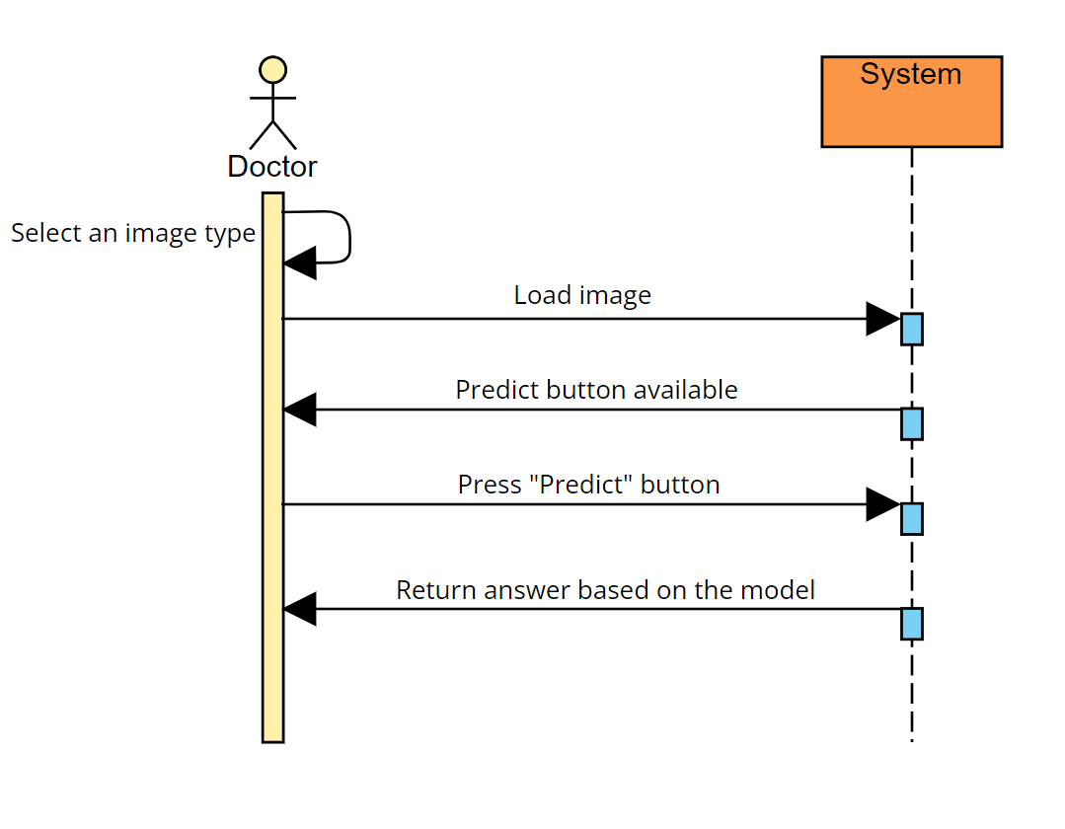
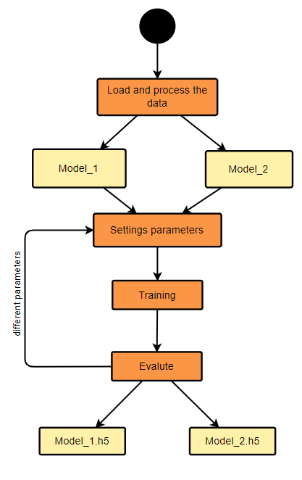
Diagrams
Sequence diagram:
14
Notes:
Tomer

Slide 15
Technologies
The programming language that was used to write the system is Python.
We used the following libraries for our system:
Keras: used for the CNN models, layers, loss and optimizer.
Os: used loading the data from the folders.
Sklearn: used for the train test data split.
Matplotlib: used to plot the accuracy and loss graphs.
Pyqt5: used for the Gui.
Tfrecords: simple format for storing a sequence of binary records.

Slide 16
Google Collab
Collab allows anybody to write and execute python code through the browser in a similar fashion to the populer jupyter notebook.
Collab requires no setup to use, providing access free of charge to computing resources including GPUs and CPUs on the cloud.
Collab resources are not guaranteed and not unlimited, and the usage limits sometimes change.

Slide 17
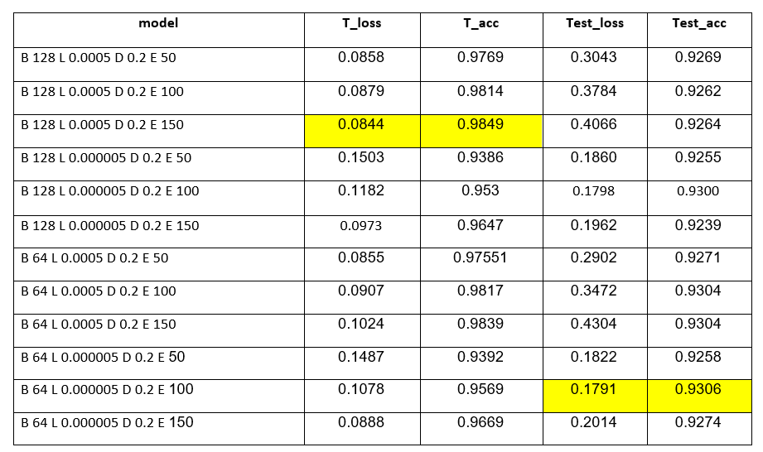
Results Mammography
DenseNet-121

Slide 18
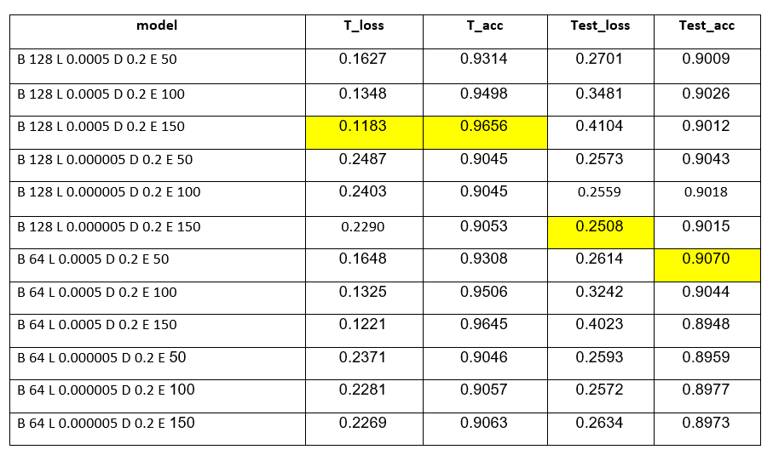
Inception V3

Slide 19
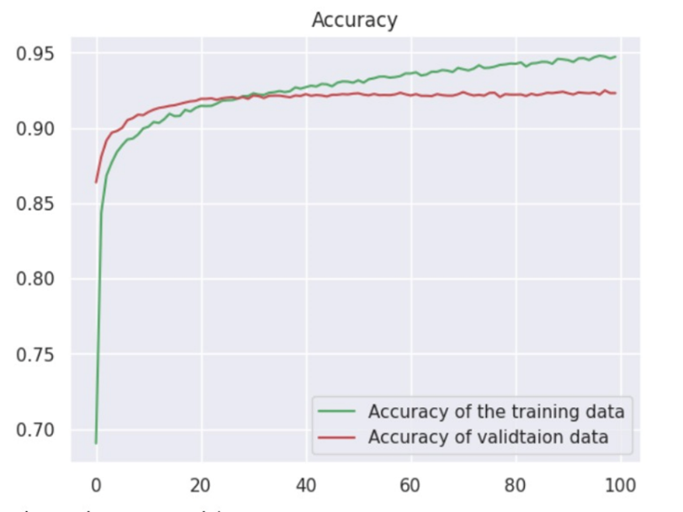
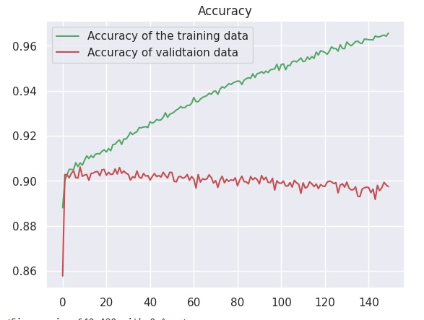
Best result Mammography
DenseNet-121
Inception V3

Slide 20
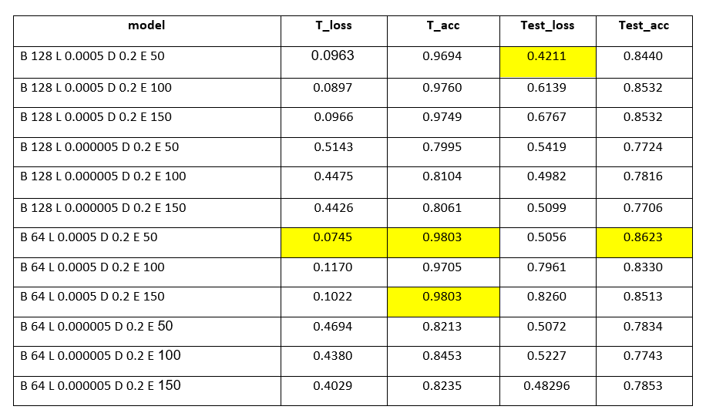
Results Histopathology
DenseNet-121
Notes:
Shenhav

Slide 21
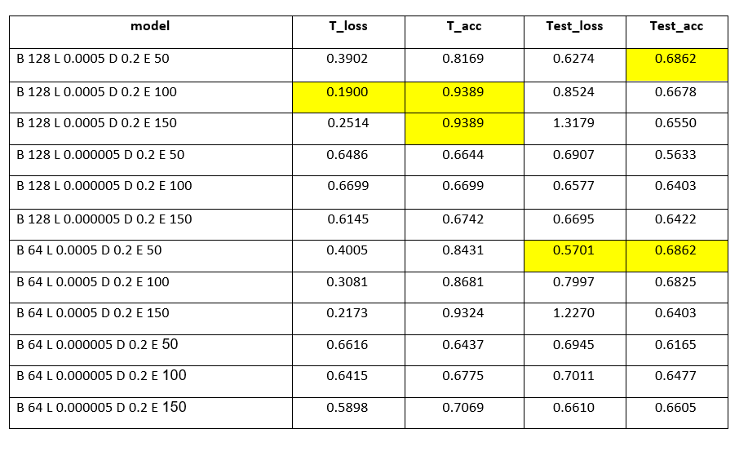
Inception V3

Slide 22
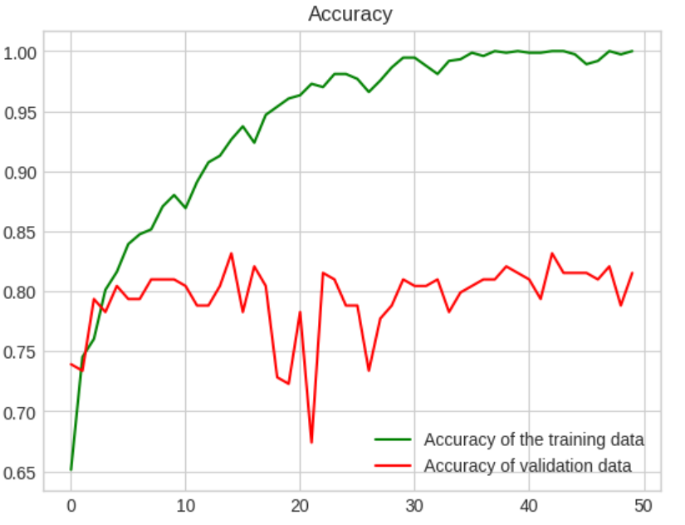
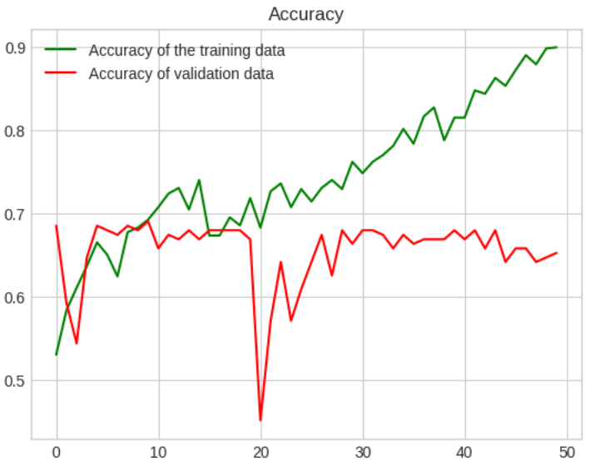
Best results histopathology
DenseNet-121
Inception V3

Slide 23
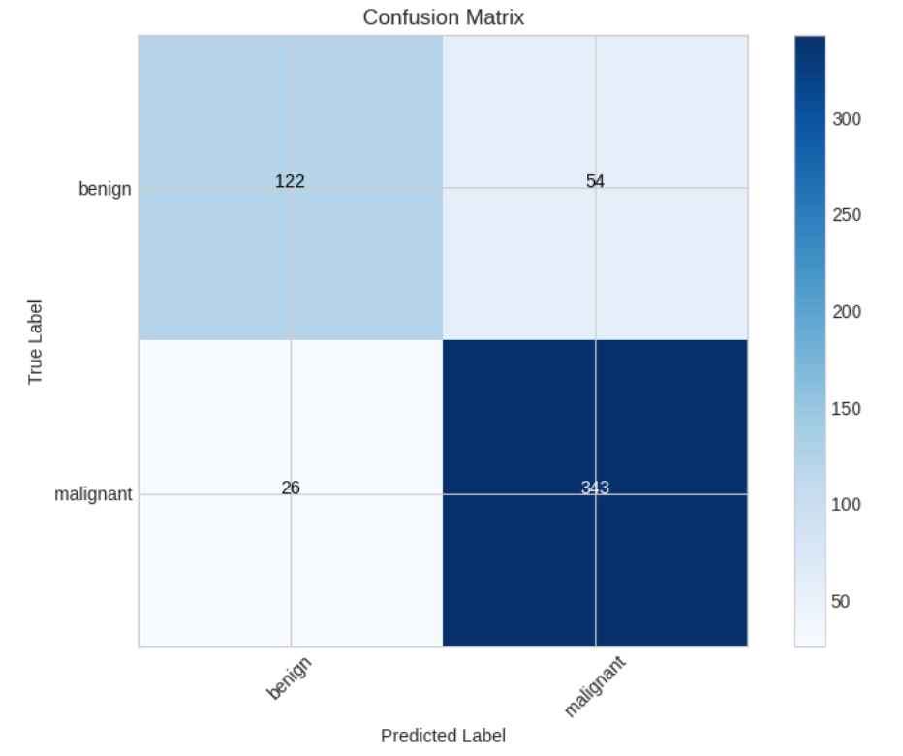
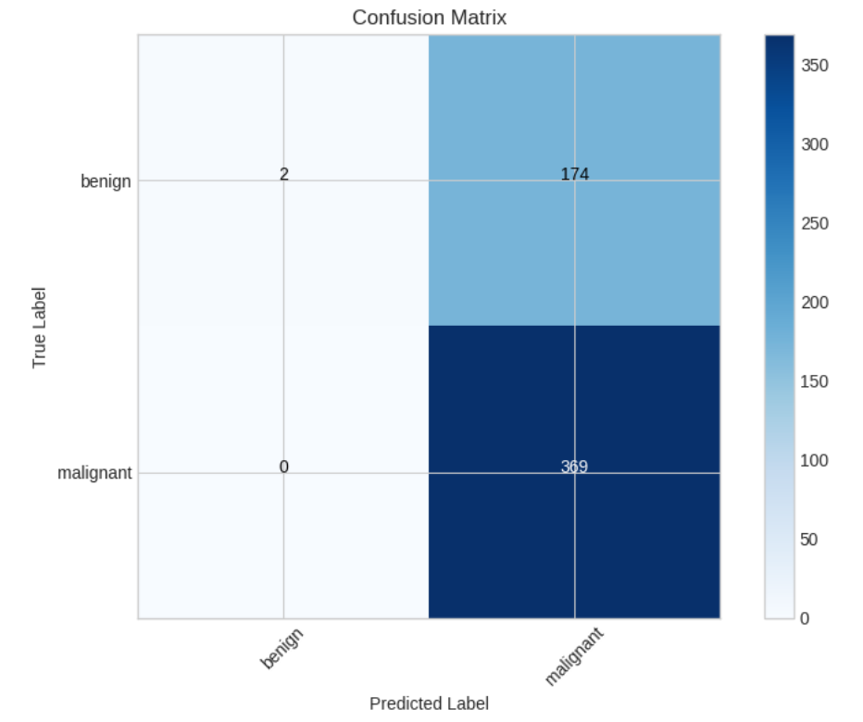
Comparison
DenseNet-121
Inception V3
Accuracy: 0.8532
Precision: 0.8640
F1 Score: 0.8956
Accuracy: 0.6807
Precision: 0.6796
F1 Score: 0.8092

Slide 24
Obstacles and solutions
Inception V4 was not available in library – We used Inception V3 instead.
Lack of memory in google collab for Mammography data, Led to use TF records which we can’t use in the app – We demonstrated only Histopathology in our app.
Big dataset led to long time training – We used Google collab pro which let us use 100 GPU unit to train our models faster.

Slide 25
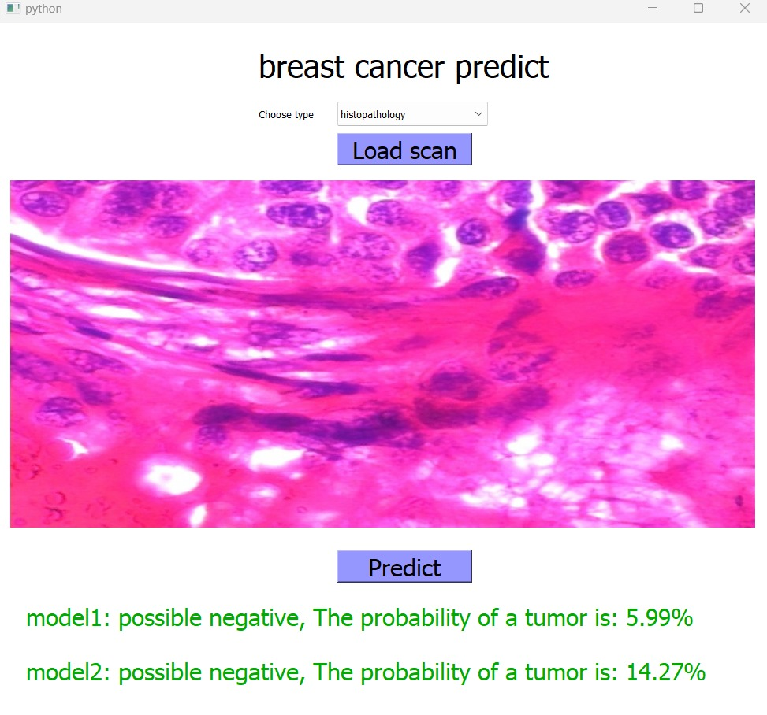
GUI
Notes:
Tomer

Slide 26
Conclusions
We have compared and found that Densenet 121 produced better results for both mammography and histopathology in terms of accuracy.
Mammography has been easier to get better accuracy.
It is possible to help medical staff with evaluation of conditions.

Slide 27

27

